Slide 1

W3C WoT Plugfest - Testbench by Marcus Wolf Schmidt & Ege Korkan March 5th, 2021 Associate Professorship of Embedded Systems and Internet of Things

Slide 2

The Testbench: Main Goals
Request Generation
Testcase Generation
Payload Generation
Automate Testing
TD
Evaluation

Slide 3
Old vs New Testbench
TD
TD
Random Data
Generation
Operation
Input
Parameter
Loop
Testing
Testing
Evaluation
Evaluation

Slide 4
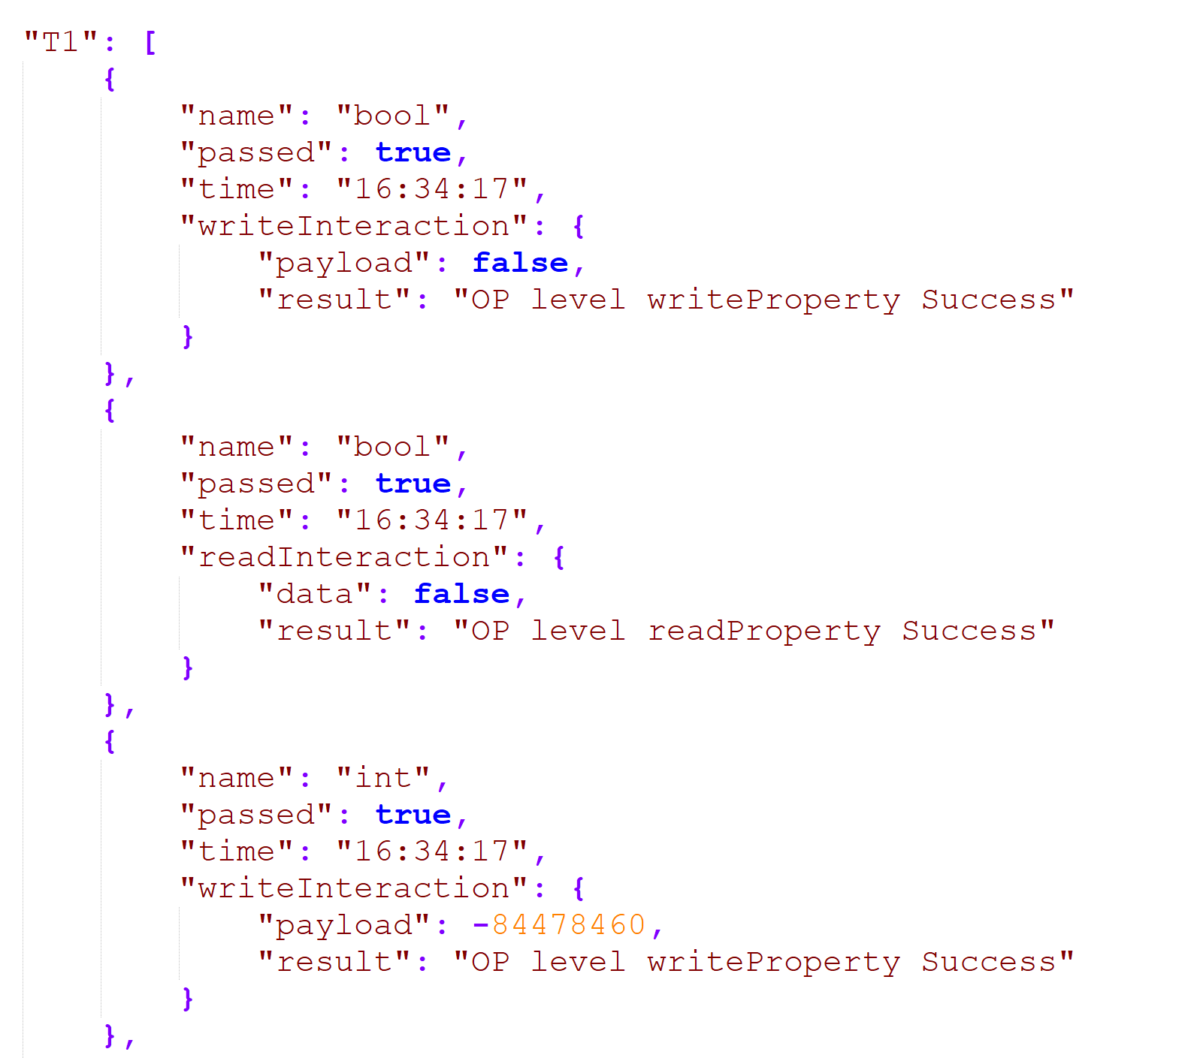
Test Report
T1 : Operation Coverage
T2: Parameter Coverage
T3: Input Coverage
T4: (Output Coverage)

Slide 5
Things I have interacted with
Things | Reachable | Tested
RIOT OS | True | True
Siemens | True | True
Oracle | Partially True | Partially True
Intel | False | False
Hitachi | False | False
Farmsimulation | True | True
TUM | True | True

Slide 6
Results
Things | Operation (T1) | Parameter (T2) | Input (T3) | Output (T4) (not done yet) | Points of Interest
RIOT OS | Passed | No Parameters | No Inputs | Passed | Stress Testing
Siemens | Passed | Passed | Passed | Passed | Uri Variables
Oracle | Passed | Passed | Passed | Failed | Output Definition
Farmsimulation | Passed | Passed | Passed | Passed | Servient Shutdown
TUM | Passed | Passed | Partially | Passed | Sensehat Library

Slide 7
WoT-Testbench
https://github.com/tum-esi/testbench

